Slide 1

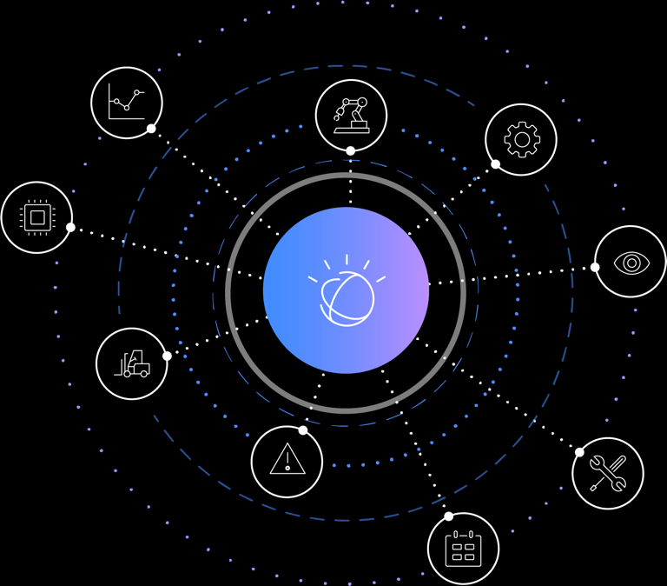
Section 1
Watson IoT Platform
Overview

Slide 2
IoT Introduction

Slide 3






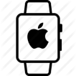







IoT: Driving digital disruption into the Physical World
Accelerating Advancements in Technology… Are transforming every part of business…
Improving Operations and Lowering Costs
Predictive maintenance
Analyze and reduce risk
Factory automation
Advanced Analytics
Product Lifecycle Mgmt
Cloud Computing
Pervasive Connectivity
Embedded Sensors
Creating New Products and Business Models
Smarter, safer cars
Health and fitness
Home and building automation
Driving Engagement and Customer Experience
Smarter, more profitable retail
Engaged events and venues
Apps that link the digital and physical world around a brand

Slide 4
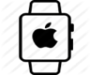












What is an IoT Platform?
Making devices available to applications
Devices
Platform
Applications
01
0110
0010
001001
Other
Data Sources
Sensors & Networks
Weather
Map
Other IoT platforms

Slide 5

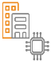
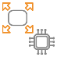

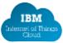
The IoT value chain
Opportunity for partnerships right across the IoT value chain to provide end-end IoT solutions
IBM IoT Industry solutions
IBM GBS services
Industry sales & distribution expertise
Connectivity & Security technology
Connectivity & Security technology
Connectivity, Security and edge analytics
Relationships & reach
IBM Cloud platform
Watson IoT Platform
IBM
Silicon
IoT Devices
Gateways
Networks
Cloud
Solution
& Applications
Oil & Gas
Energy & Utilities
Smarter Cities
Consumer Electronics
Connected Vehicle
Transport & Rail
Life Science & Healthcare
Industrial Manufacturing
Your silicon, embedded OSes &
Recipes
Your IoT devices & recipes for connecting them
Your gateway and recipes for connecting them
Your network
Additional value add cloud services
Customer solutions built on IBM IoT technology
Partners
End-end IoT solution

Slide 6
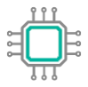
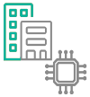
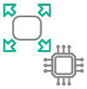





Watson IoT Partnerships
Watson IoT provides end to end solutions with strong industry partnerships across the IoT landscape
Connectivity &
security technology
Connectivity &
security technology
Connectivity, security
& edge analytics
Relationships
& reach
IBM Cloud
& IoT Platform
IBM IoT industry solutions
IBM
Silicon
IoT Devices
Gateways
Networks
Cloud
Solution & Applications
Partner
End-end IoT solution
Notes:
We should not forget that IoT is not a “point solution” – it requires multiple components – from the low-level hardware, like specialised sensor chips, through hardware packages, like devices, to gateways and networks that provide interconnection to the cloud – where our IoTCS solution operates, together with the extensions and industry-specific capabilities we talked about earlier.
IBM has a broad ecosystem of partners who play in each part of this ecosystem, so our customers can be assured that when they bring any scenario to us, we can assemble an end-to-end solution that will address their requirements.

Slide 7
IBM Watson IoT Platform

Slide 8




IBM Watson IoT Platform
Connect
Information Management
Analytics
Risk Management
Secure Connectivity
Attach: MQTT, HTTPS
Collect & Organize
Device Management
Visualization
Predictive
Cognitive
Real-Time
Edge
Proactive Protection
Anomaly Detection
Blockchain
Firmware Updates
Store & Archive
Metadata Management
Reporting, Parsing and Transformation
Manage unstructured data
IBM Cloud Open Standards Based Services
Full Development Lifecycle DevOps Services IBM Security
IBM Watson IoT Platform

Slide 9
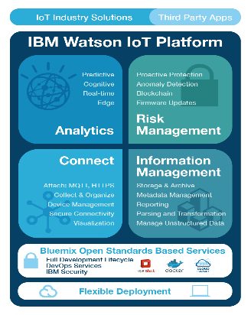
IBM Watson IoT Platform - Connect
Connect what matters
The Hub for IoT Devices
Connect and manage your IoT Devices, Gateways and Networks from a broad and growing ecosystem
Open standards based communications (MQTT, HTTPS)
Secure communication and management
Globally scalable, starting with a single device

Slide 10
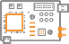












Watson IoT Platform ‘Connect’
Device connectivity and management
Your device or gateway
We start with your device, be it a sensor, a gateway or something else.
To find out how to get it connected, search our recipes.
MQTT
IBM Watson IoT Platform Connect
This is the hub of all things IBM IoT. This is where you can setup and manage your connected devices so that your apps can access their and historical data.
Your device data is sent securely up to the cloud using the open, lightweight MQTT messaging protocol.
REST & Real-time APls
Use secure APIs to connect your apps with the data coming from your devices.
Your application and analytics
Create applications within IBM Bluemix. another cloud, or your own servers to interpret the data you now have access to!

Slide 11
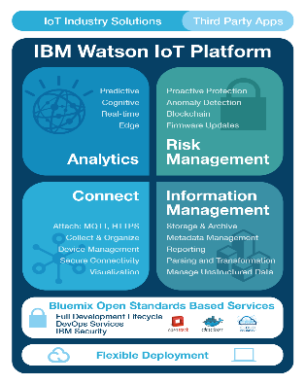
IBM Watson IoT Platform
Information Management and Analytics
Deal with data from millions of devices continuously in the cloud
Combine contextual data with analytics and IoT data to deliver better outcomes
Handle Data Storage requirements
Historical streaming to No-SQL database
Long-term cold storage with Cloud Object Storage
Use for historical Data Analytics
Apply Machine Learning
Integrate critical data from other information platforms such as Weather and social sentiment and other IoT platforms
Leverage advanced capabilities for data storage, caching and transformation
Improve visibility of IoT systems through rapid dashboarding

Slide 12
IBM Watson IoT Platform - Risk Management
Leading Security Capabilities
Enforce the appropriate level of security and privacy to your IoT solution from the device through the network to the cloud and beyond
End to end core security features for devices, data and connections
Gain system wide confidence via Security Analytics
Provide support for secure decentralized systems such as Blockchain

Slide 13

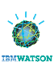


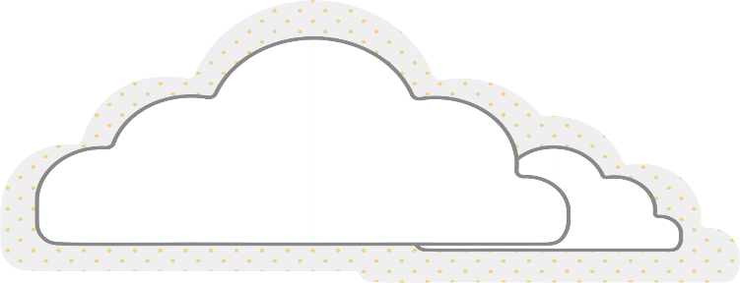







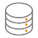


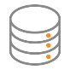

Watson IoT Platform Components
Watson
IoT Platform
Connect
3a
Real time data consumed by
RTI analytics or customer
applications
Interact with devices
via Connect
4
Cached or historical data
consumed by customer
applications
1a
Real-time data
MQTT or HTTP
IBM Watson IoT Platform Connect
3b
Latest values made available in fast cache
1b
Interact with devices
via 3rd party platforms
2
Data is parsed,
Filtered, transformed as required
3c
Historical values stored in datastore of choice
1c
Ingest data from 3rd party source
5
Data stored externally
for archive or off-platform
analytics

Slide 14
IBM IoT Portfolio

Slide 15
IBM IoT portfolio big picture
Integrated IoT solutions built on the platform foundation
Core business needs
Software & Systems Engineering
Enterprise Asset Management
Facilities Management
AI Assistants
Time to Revenue
Quality
Traceability
Availability
Performance
Asset Lifecycle Optimization
Cost Optimization
Space Utilization / Revenue
Total Cost of Ownership
Customized Experience
Loyalty and Engagement
Revenue Growth
How IBM can help
Agile Software Development
Requirements Management
Model-based System Engineering
Compliance Management
Quality Management
Enterprise Asset Management
Asset Performance Management
MRO Inventory Optimization
Production Quality Insights
Production Optimization
Worker Safety Insights
Facilities and Lease Management
Building Insights
Facilities Optimization
integrated
Watson Assistant for Industries
Watson Assistant for Automotive
Watson Assistant for Hospitality
IBM solutions
Continuous Engineering
Maximo
TRIRIGA
Watson Assistant
Connected Solutions
Watson IoT Platform
Connect, Collect, Process, Optimize
Tailored insights from AI and analytics
Trust and tracking within a shared Blockchain ledger
Industry solutions with pre-integrated
AI / Machine Learning capabilities
IBM Services
Industry, domain
and IoT expertise

Slide 16

Watson IoT Platform SaaS
The WIoTP SaaS offering is a bundle of several services
Connection Service (same as PaaS)
Includes managed historical storage to PostGreSQL or DB2WH, and COS
Optional Analytics Service
Blockchain Service (optional)
This is a cloud-based SaaS with a monthly subscription
Starts at $500/month for non-production instance
Production instance priced based on volume tiers
Watson IoT Platform
Integrated managed service with SLAs and unified per device pricing
Connection Service
Securely connect and store
Analytics Service
Explore AI-driven insights
Blockchain Service
Govern and deliver
Notes:
This chart illustrates (at a high level) how the portfolio of IoT solutions has been put together.
Starting at the bottom:
Watson IoT platform is the foundation for the portfolio – many of the industry-specific solutions are built on the ability to connect devices and collect data, which is what platform provides. Platform is a cloud-based SaaS solution – and we’ll explain more details in the next few slides.
Industry models that provide pre-built integrations and analytical/predictive models for different domains – for example, to analyse driver behaviour in connected vehicles, to detect dangerous situations for works in hazardous environments, etc

Slide 17
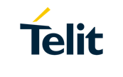
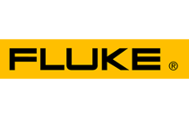

Watson IoT Platform Connection Service
Secure, scalable connectivity and integration for the IIoT
Open standard based communication for IoT
Industrial Integration
MQTT
Lightweight, efficient, bi-directional and optimized for IoT
HTTPS Wide reaching and secure to reach more devices
IBM Integration Bus
Manufacturing pack integrates with OPC UA/Classic and OSI PiServers
Telit Devicewise
Connect to PLCs, MES, ERP, and see the data in the Watson IoT Platform
Fluke Connect2Assets
Bring PLC and SCADA data directly to Watson IoT Platform and/or Maximo
Secure device registry
Device properties and metadata
Security Credentials
Connection status
Notes:
Fluke – Local SCADA Network, Siemens, Wonderware InTouch, Schneider Electric, OPC

Slide 18
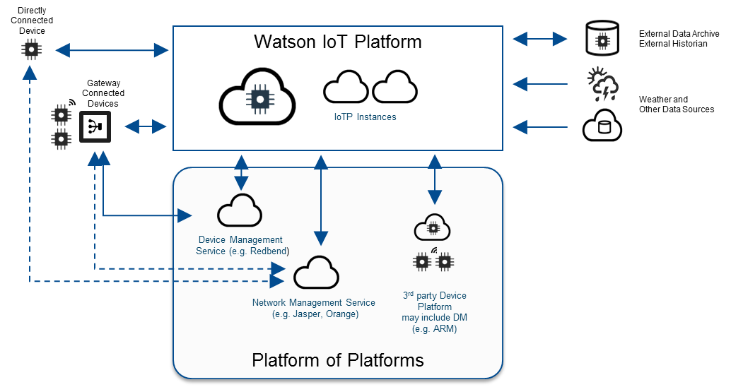
Watson IoT Platform Connection Service
Flexible device and system management for your IoT devices and applications
Device Management
Flexible device management console provides a preconfigured means to send events such as device reboot, factory reset, or custom device functions such firmware management and upgrades.
Gateway Management
Extra functionality and control with gateways as first class type, enabling single connection actions, automatic registrations, and device management on attached devices as separately addressable entities
Platform of Platforms
Watson IoT Platform can be integrated with other platforms including 3rd party device and network management platforms and enable system management with specialized services such as AT&T Control Center, Jasper, Orange SIM
Notes:
Fluke – Local SCADA Network, Siemens, Wonderware InTouch, Schneider Electric, OPC

Slide 19


Watson IoT Platform Connection Service
IoT data management features
Transform & Cleanse
Use devices schemas and logical interfaces to insulate applications from variability across device types, sensor models, variants and versions
Store & Archive
Use Data Lifecycle Management to optimize storage utilization and reduce costs, whilst retaining flexibility.
Data lifecycle management takes care of limiting the growth of data in the various data stores (DataBase vs Object Storage) within the solution. Without this, the data size would continually increase, and associated costs would grow. Data Lifecycle automatically purges older data and moves long term data to low cost storage.
Notes:
Example: Several different models and brands of temperature sensor represented by a single common logical interface

Slide 20
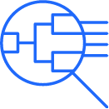
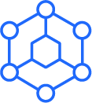
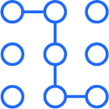
Watson IoT Platform Analytics Service
Explore, visualize and gain insight from your data with AI driven analytics
Explore and visualize data patterns of your IoT data
Enrich data with analytic functions that are focused on business KPIs
Extend catalog with advanced and custom models including AI
Deep Learning and Machine Learning
Combine supervised and unsupervised learning along with machine learning libraries and optimization algorithms to improve operations, performance, and KPIs
Semantic Reasoning
Visualize how data relate to each other through knowledge graphs with semantic reasoning
*Advanced capabilities available through industry solutions

Slide 21


Watson IoT Platform: Analytics
Watson IoT Platform Analytics Pipeline
Connect
Merge
Augment/
cleanse
Aggregate/
Enrich
Store
Expose
Consume
Analytics Service
Applications
Analytics configuration and execution
Connection Service
Data lake
Dashboard
Analytics Function Catalog
Solutions
Explore /
Discover
Develop
Extend

Slide 22
Industrial IoT architectures with Watson IoT Platform

Slide 23


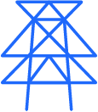




Watson IoT Platform Industrial References
Watson IoT Platform is improving outcomes in key industries
Manufacturing
Transportation
Utilities
increased 10% equipment effectiveness (OEE) and 20% operational efficiency
Saving up to $80,000 a day in shipping costs
Prevent contamination in 40% of tanks with early detection
increased production by 10% by predicting issues and avoiding downtimes
Reduce maintenance cost of tracks and trains by 10X
Saving up to 20% in energy costs to customers
improved quality by 50% and achieve 90% on time delivery
5% improvement in unloading times and vessel utilization
Increase rig utilization by 5% by increasing efficiencies across their fleet

Slide 24
Industry 4.0 Reference Architecture
IBM’s 3-tiered Industry 4.0 Reference Architecture Leverages Hybrid Cloud strategy, laying the foundation for Digital Transformation at the factory floor
EDGE
PLANT
ENTERPRISE
Edge - Level
Plant - Level
ENTRY POINT:
Enterprise - Level
ENTRY POINT:
Prereq
ENTRY POINT:
ENTRY POINT:
Off-load
Value
Strategy
improve
… need for Cloudifying the Plant
analyze
New models, speed, functions, channel
control
Shopfloor Analytics & Workflow
IoT Platform
Cyber-Physical Systems
collect
EDGE DEVICES
Cross-plant Insights & Analytics
Plant Service Bus
Cognitive IoT functionality:
Innovation
Disruption
Scalability
Containerized SW functionality:
Rules
Store
Analytics scoring
Filtering
In-plant functionality:
Connectivity
Rules
Message Hub
In-plant or remote functionality:
Connectivity
Data collection
Conditional Monitoring
Predictive analytics
*Refer to Industrie 4.0 Implementation at: https://www.ibm.com/devops/method/content/architecture/iotArchitecture#industrie_40

Slide 25
Hybrid multicloud IoT Architecture
Combining New Apps Deployment with Legacy Modernization and Location-Agnostic App Deployment = Immediate ROI
Edge - Level
Plant - Level
Enterprise - Level
modernization
re-base
Cloud Pak 4 Mfg
Virtualized Legacy Apps
CP4M Apps
IoT Apps
Partner Apps
Legacy applications
IoT Apps
Spec. HW
OpenShift
Virtualized HW
5G MEC
Any / Multi Cloud Providers: AWS, Alibaba, Azure, Google, IBM, …
Production Zone
IT Zone

Slide 26
Plant Service Bus components
Flexible Integration, combined with Supreme QoS and Data Privacy Enforcement at the Shop floor
Classical service bus functionality for de-coupled integration of systems and machines, taking over integration logic, systems/machines, relief from integration-specific logic, enabling standardization of maintenance and release management
Flexible configuration at shop floor, integration layer and machine level based on rules defined in natural language, validated and deployable by production planner (non-IT) staff; streamlining change management, plug & produce enabler
Message Hub for MQTT messages for scalability, performance and off-load
PSB
Rules Engine
Integration
Message Hub
IBM ODM Rules
IBM App Connect for Manufacturing
WIoT Msg. Gateway

Slide 27
Hands-On Labs introduction

Slide 28

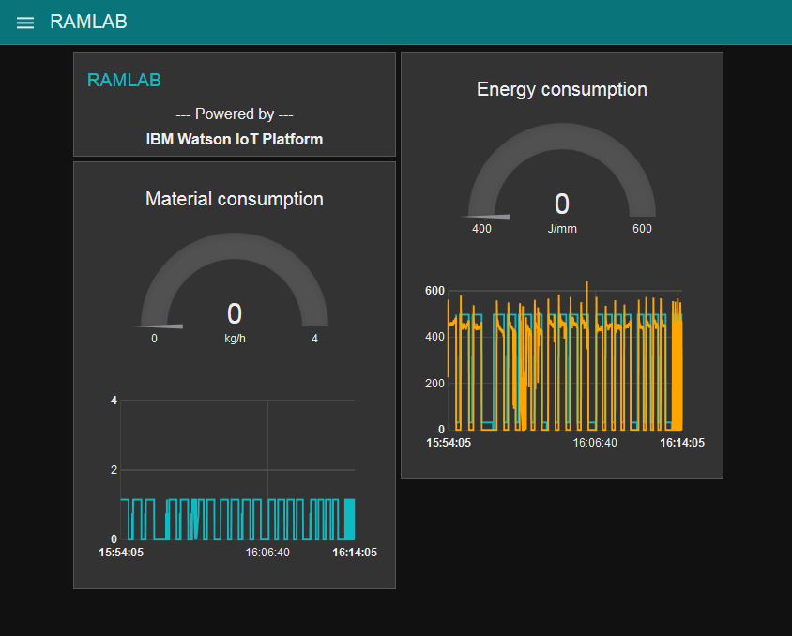


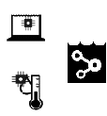
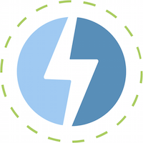
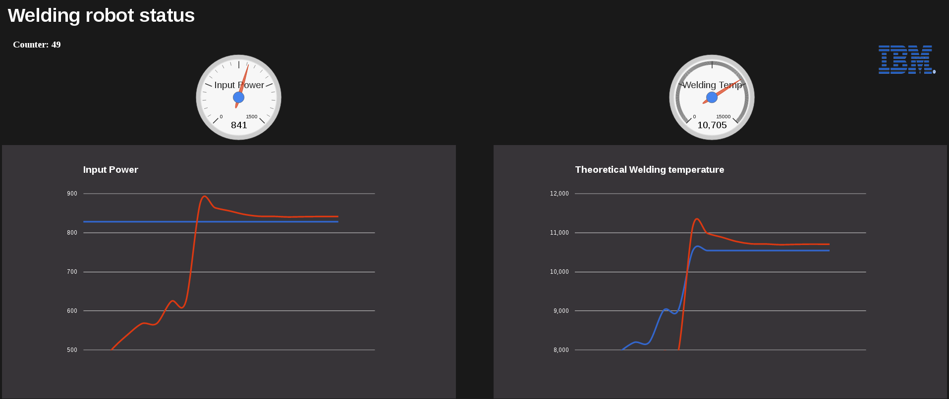

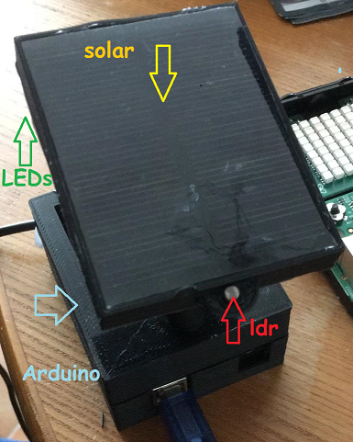
Architecture to leverage IBM Cloud Analytics
Hands-on Labs scope
Lab 4
Lab 2
Operator
Dashboard
Cloudant
Datastore
Watson Studio
Analysis
Other sources
Raw events
Lab 1
Raw events
Aggregated values
Raw events
Watson IOT
Platform
Streaming
Analytics
Analytics
Dashboard
Feedback loop
(predicted errors, control)

Slide 29
Lab 1
Lab instructions and material at
https://ibm.box.com/v/WatsonIoTWS2019
Lab1_SmartLampConnect.pdf
Connecting the IoT device to Watson IoT Platform
Wifi router: TP-LINK_2B5398
Password: 5martCity
Raspberry Pi Node-RED URL
http://192.168.0.20X:1880 where X is you Raspi’s number (1-9)

